Slide 1
Phonetics & Phonology
Or: Why "Ghoti" sounds like "Fish"

Slide 2





Intro Quiz: Trust Issues
Q: Why shouldn't you trust English spelling?
Option A
Option B
Option C
Because "ough" has 9 different pronunciations.
Because "phonetic" isn't even spelled phonetically.
Because the alphabet was designed by chaos demons.
(Spoiler: They are all correct.)

Slide 3
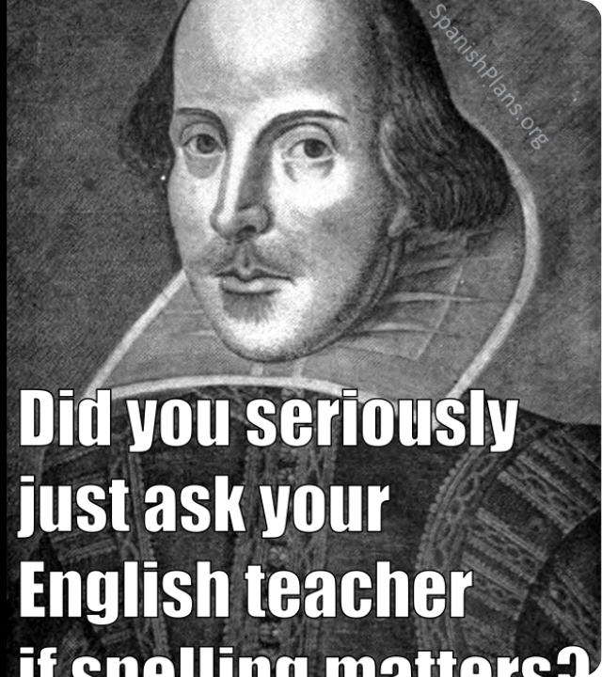
Meme Placeholder
To the User: Please paste your "IPA Beer" meme here.
Concept:
•
Customer: "I'd like an IPA."
•
Bartender: "wɪtʃ bɪə wʊd juː laɪk?"
•
Caption: Be careful what you ask for.

Slide 4


The Rules of Transcription
Don't write letters. Write sounds.
•
[ ] Square Brackets: Phonetics (The physical sound).
•
/ / Slanted Brackets: Phonology (The mental category).
[ b æ ŋ ]
•
< > Angle Brackets: Orthography (The spelling).
Fun Fact: "Bang" ends with [ŋ]. There is no [g] sound, despite the spelling. "Photo" and "Enough" share the same [f] sound.

Slide 5


Intro Quiz: Air Traffic Control
Q: What is the difference between a "Stop" and a "Fricative"?
Option A
Option B
Option C
A Stop blocks air completely; a Fricative creates friction.
A Stop is a red light; a Fricative is a yellow light.
A Fricative is just a Stop with commitment issues.

Slide 6

Meme Placeholder
To the User: Please paste your "Suez Canal Ship" meme here.
Concept:
•
Left (Fricative): Ship moving through narrow gap.
•
Right (Stop): Ship stuck sideways blocking everything.

Slide 7
Manner of Articulation
Stops (Plosives)
Fricatives
Block airflow completely, then let it explode.
Almost block airflow, squeezing it through a narrow gap.
•
Voiceless: [p], [t], [k]
•
[f], [v], [s], [z], [h]
•
Voiced: [b], [d], [g]
•
"My love for you is like a fricative... it never stops."
Affricates: The Remix. Start as a stop, release as a fricative (e.g., [ʧ] "cheap").

Slide 8
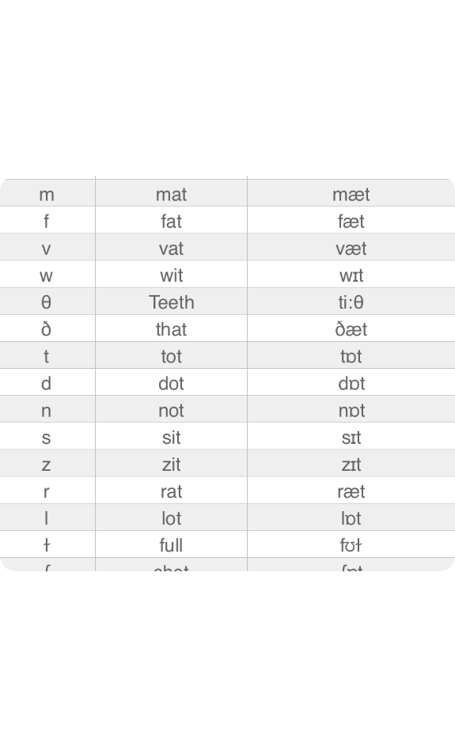

The Consonant Chart
This chart maps sounds by:
•
Place: Where in the mouth? (Lips, Teeth, Palate)
•
Manner: How is air blocked? (Stop, Fricative)
•
Voicing: Are the vocal cords vibrating?

Slide 9





Intro Quiz: Tongue Gymnastics
Q: To make the sound [i] (as in "heat"), where is your tongue?
Option A
Option B
Option C
High and to the Front.
Relaxing on the sofa.
Trying to escape your mouth.

Slide 10

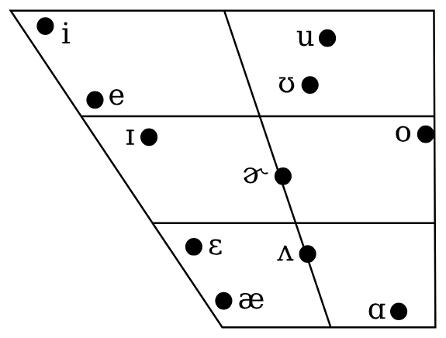
The Vowel Quadrilateral
Mapping the Mouth
•
High Front [i]: "Bead" (Mouth closed, tongue forward).
•
Low Back [ɑ]: "Bob" (Mouth open, tongue back).
•
The Schwa [ə]: The sound of laziness. Central, unstressed, effortless. (e.g., "About").

Slide 11



Diphthongs: Vowels on the Move
[ aɪ ]
[ aʊ ]
[ ɔɪ ]
Buy, Eye, My
Cow, Doubt
Boy, Noise
Gliding from Low to High
The "Ouch" sound
The "Oy Vey" sound
Accent Note: Americans pronounce the final [r] in "Car". British English drops the [r] and often uses diphthongs instead.

Slide 12



Intro Quiz: Perception
Q: If a Phonologist looks at a dog, what do they see?
Option A
Option B
Option C
A contrastively meaningful sequence of segments.
A good boy.
[ d ɔ g ]

Slide 13


Phonemes vs. Allophones
Phoneme / /
Allophone [ ]
The Mental Idea.
The Physical Reality.
If you swap a phoneme, you change the meaning.
Different versions of the same sound.
Example: Fat vs. Vat.
Example: The [t] in Tar (exploded) vs. Star (soft).

Slide 14
Meme Placeholder
To the User: Please paste your "Futurama Fry" meme here.
Concept: "Not sure if those are allophones or different phonemes."

Slide 15



Intro Quiz: Rhyme Time
Q: Which of these is a "Minimal Pair"?
Option A
Option B
Option C
Fan and Van.
Orange and Door-hinge.
Tomato and Tomato.

Slide 16
Minimal Pairs & Phonotactics
The Test
Phonotactics
If changing one sound changes the meaning, those sounds are distinct phonemes.
The "Rules of the Club". Some sounds just can't sit together.
•
Legal: /pl-/ (Play), /kl-/ (Clean)
•
Pair: Fan vs. Van (/f/ vs /v/)
•
Illegal: /vl-/, /nl-/, /fsig/
•
Set: Big, Pig, Rig, Fig, Dig, Wig

Slide 17



Intro Quiz: Fast Talk
Q: Why do we say "Hafta" instead of "Have to"?
Option A
Option B
Option C
Our brains anticipate the next sound (Assimilation).
Because enunciating is exhausting.
Both A and B.

Slide 18
Why We Sound Different Than We Spell
Assimilation
Elision
One sound copies a feature from its neighbor to make it easier to say.
Leaving sounds out completely (The "Ghost" sounds).
Example: "Friendship" → We usually drop the [d]. [frɛnʃɪp].
Example: "I have to" → /v/ becomes voiceless /f/ to match the /t/. Result: "Hafta".
Example: "Camera" → We don't say Ca-me-ra. We say [kæmrə].

Slide 19




Image Sources
•
https://www.rizzolieducation.it/content/uploads/2023/01/image4-1.png
Source: www.rizzolieducation.it
•
https://media.tenor.com/LeexVki7avsAAAAe/alinathehack-guy-confused-looking-at-the-paper.png
Source: tenor.com
•
https://englishlikeanative.co.uk/wp-content/uploads/2020/07/IPA-consonants.png
Source: englishlikeanative.co.uk
•
https://upload.wikimedia.org/wikipedia/commons/0/08/California_English_vowel_chart.svg
Source: en.wikipedia.org

